Slide 1
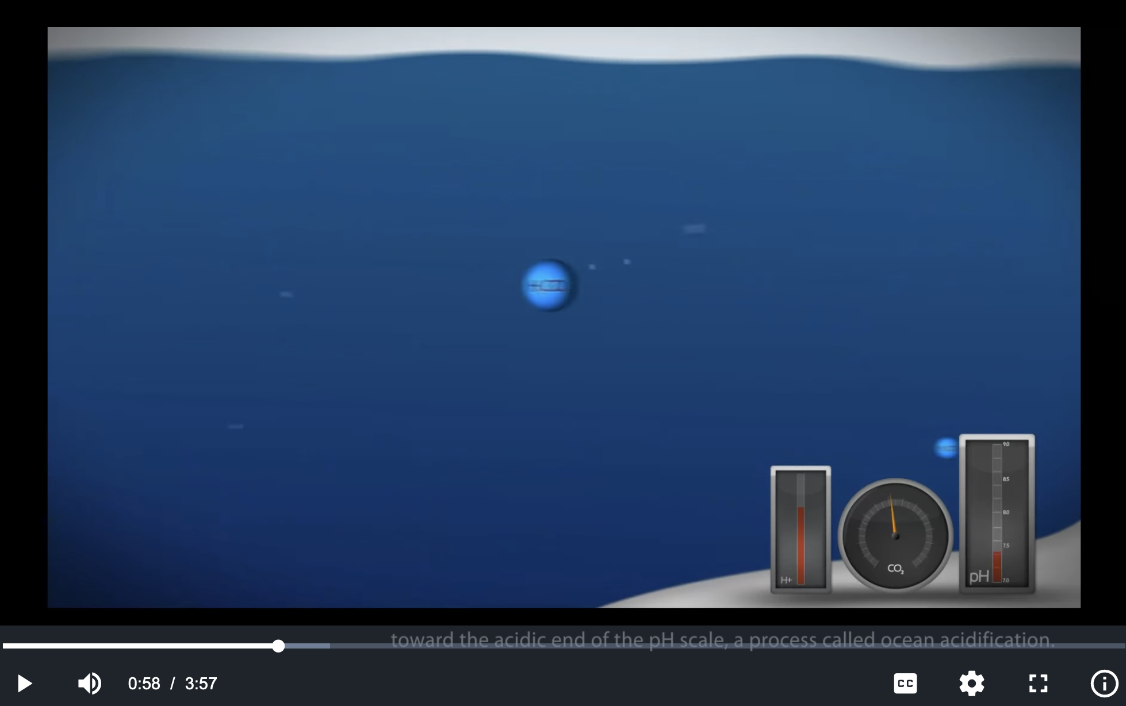
Impacts of ocean acidification
https://en.wikipedia.org/wiki/Ocean_acidification

Slide 2
Ocean pH varies according to where (and when) you are
https://toolkit.climate.gov/sites/default/files/Surface_pH_1770_2100_1s.gif

Slide 3
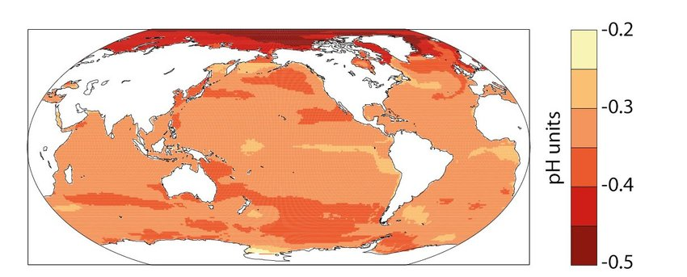
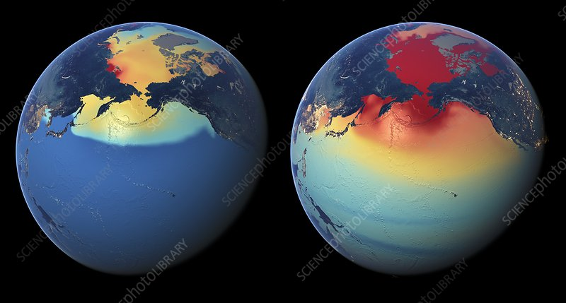
It seems the Arctic is getting hit the most
https://www.researchgate.net/publication/328166919_A_new_climate_change_vulnerability_assessment_for_fisheries_and_aquaculture/figures?lo=1
Drop in pH
https://www.sciencephoto.com/media/684079/view

Slide 4
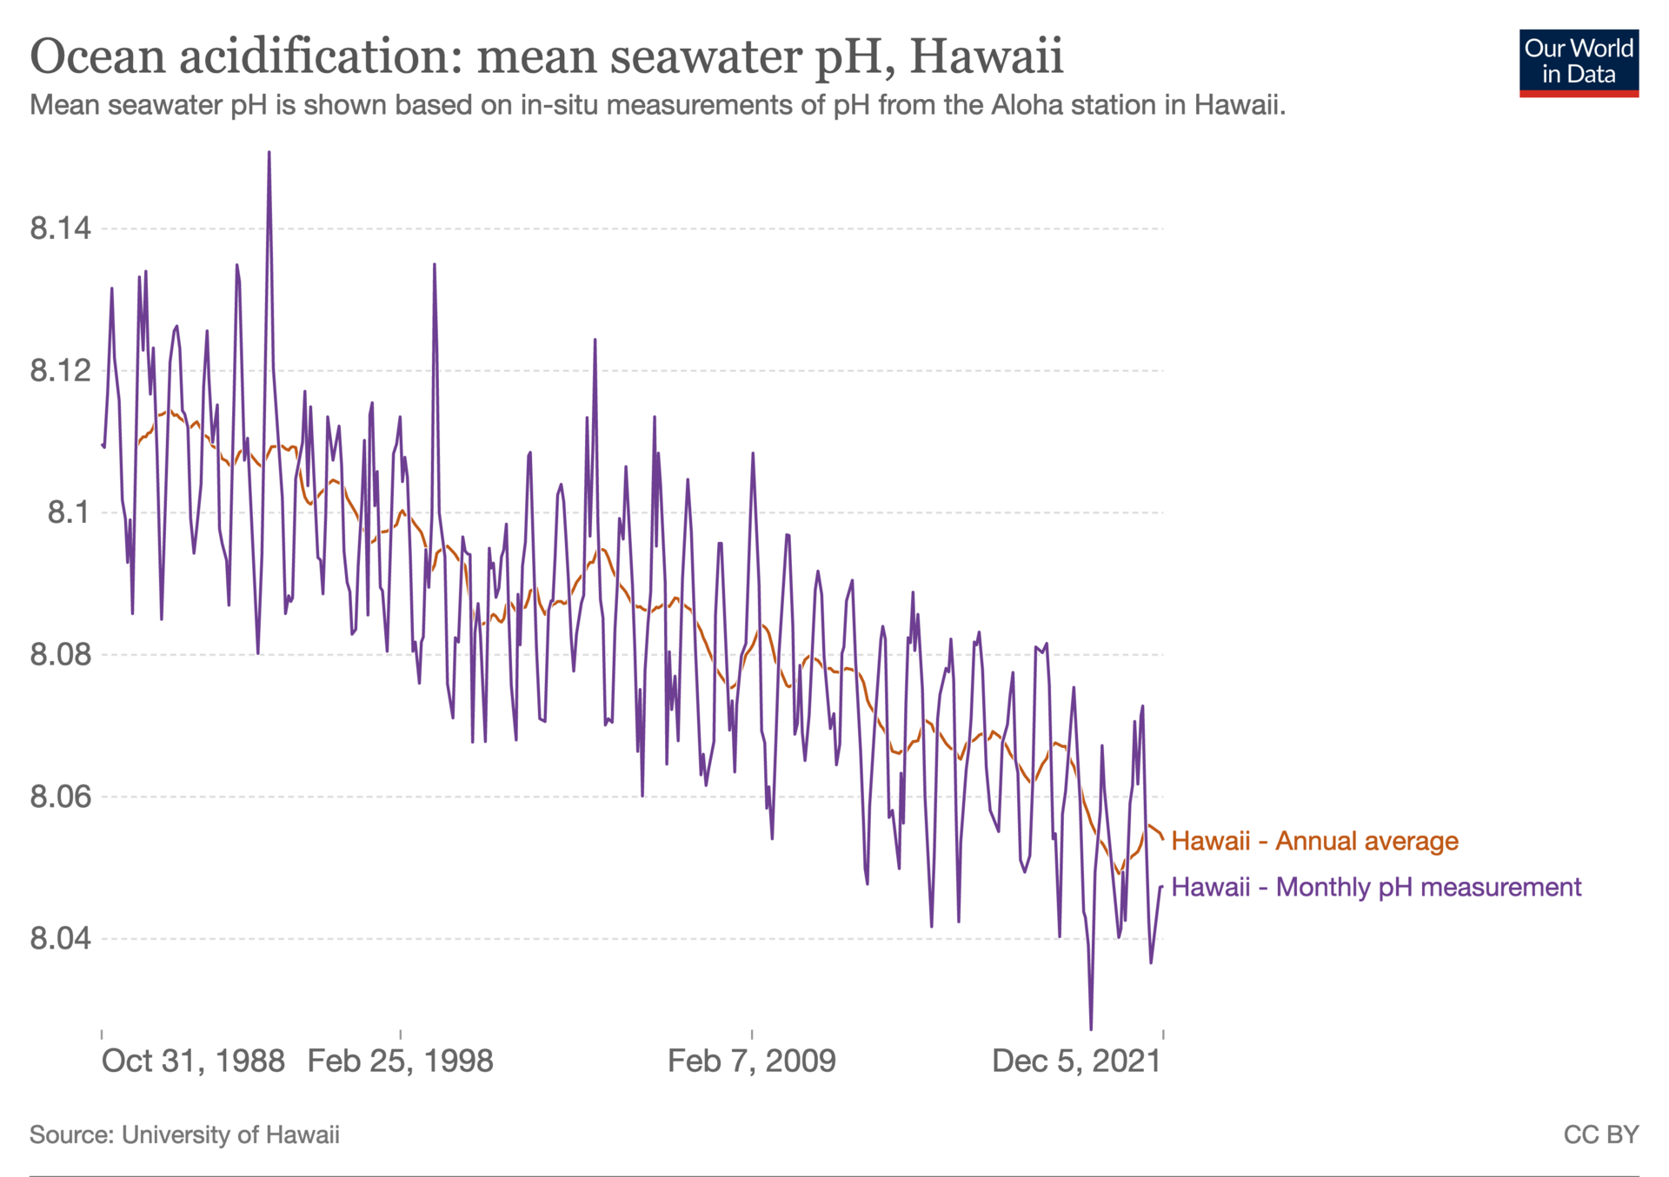
Trends in ocean acidification recorded at Aloha station

Slide 5



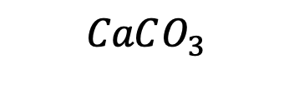








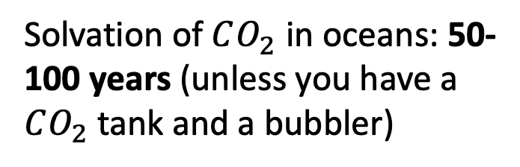
Time scale of neutralization is a lot longer than acidification
$$CO_{2}$$
Solvation of $CO_{2}$ in oceans: 50-100 years (unless you have a $CO_{2}$tank and a bubbler)
Air
$$H_{2}O$$
$$H_{2}O$$
Oceans
$H_{2}CO_{3}$
$$H^{+}$$
$$H^{+}$$
Ocean chemistry: minutes
$$HCO_{3}^{−}$$
$${Ca}^{2+}$$
$$CO_{3}^{2−}$$
Dissolving $CaCO_{3}$ (limestone) from the sea floor: thousands of years (unless you have concentrated HCl handy)
Sea floor
$$CaCO_{3}$$
$$CaCO_{3}^{}$$

